Slide 1
Introduction to SAP Cloud Platform
26-02-2018

Slide 2
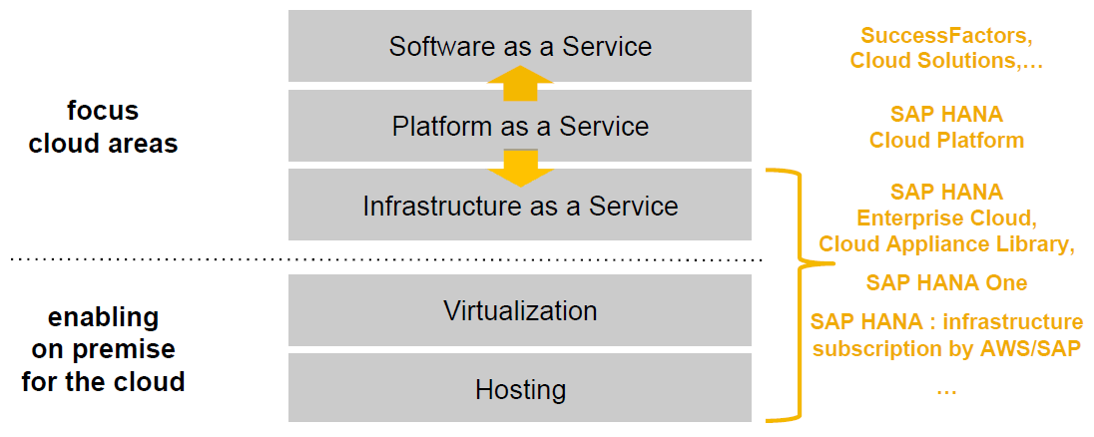
Cloud Basics - Terminology

Slide 3
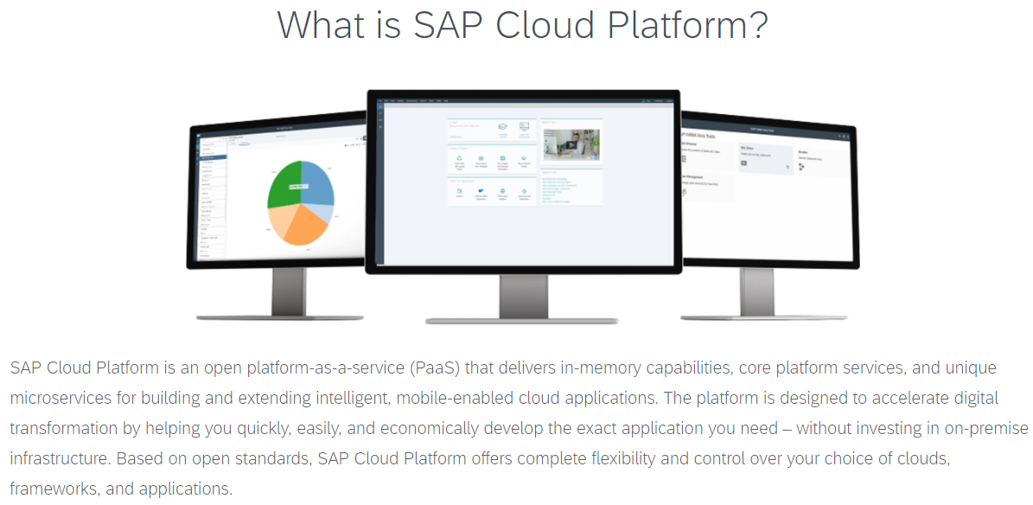
Introduction to SAP Cloud Platform

Slide 4
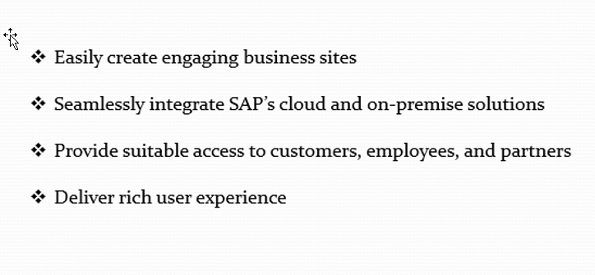
SAP Cloud Platform Key Capabilities.

Slide 5
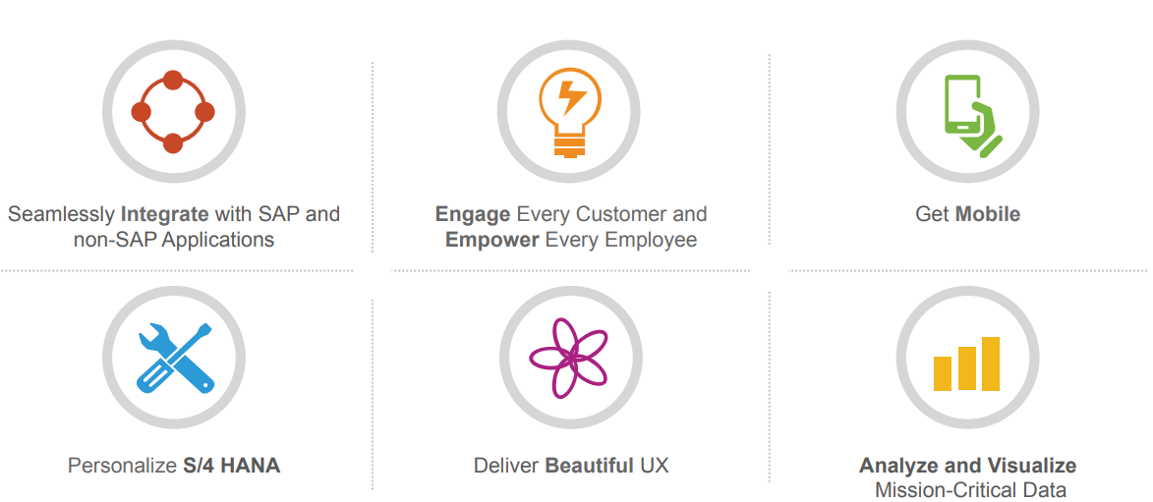
What Can You Do With SAP Cloud Platform?

Slide 6
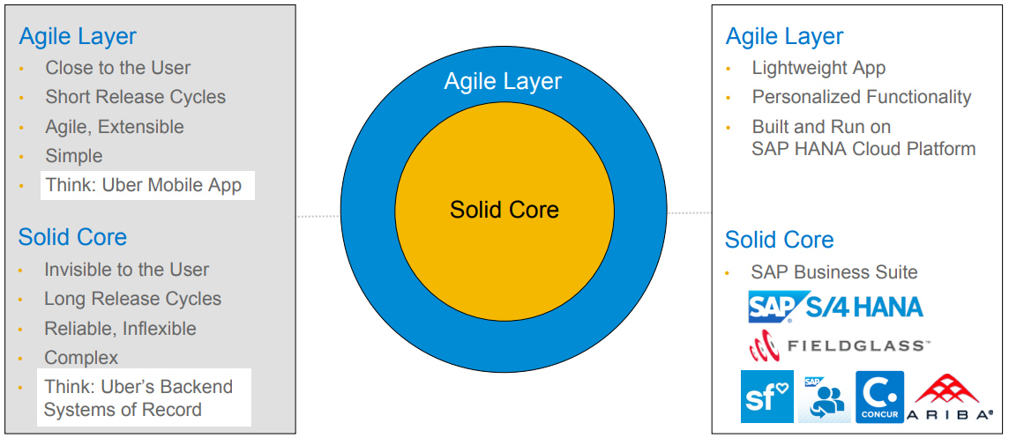
Foundation and Flexibility Powered By SAP

Slide 7
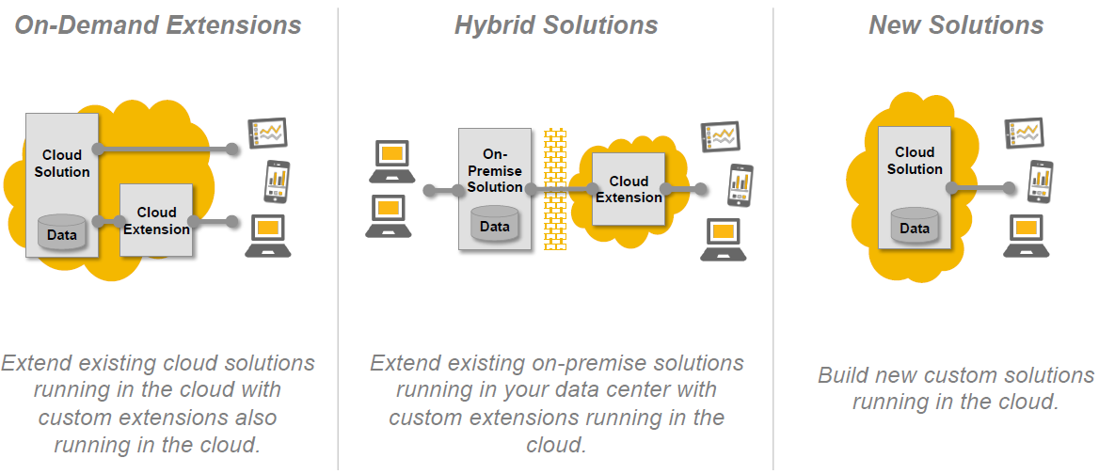
Typical Scenarios on SAP Cloud Platform

Slide 8
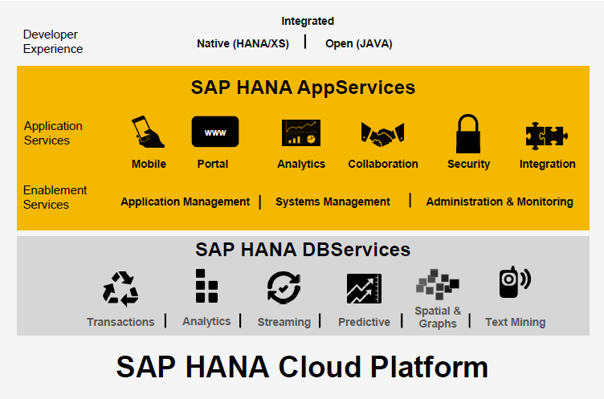
SAP Cloud Platform – High level overview

Slide 9
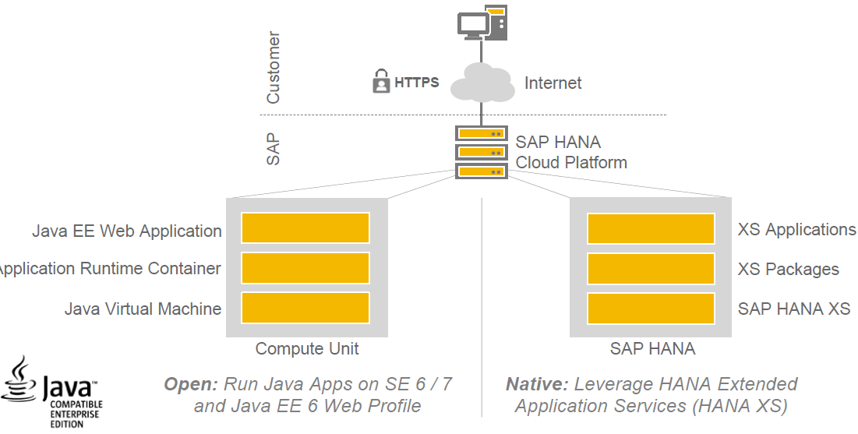
Managed SAP HANA Application Platform

Slide 10
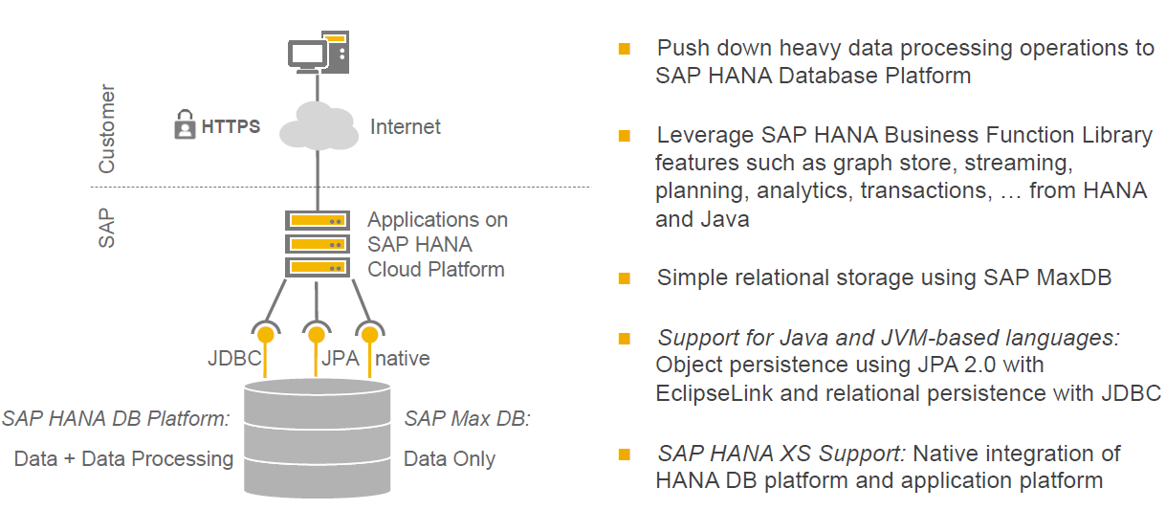
Managed SAP HANA Database Platform and Relational Persistence

Slide 11
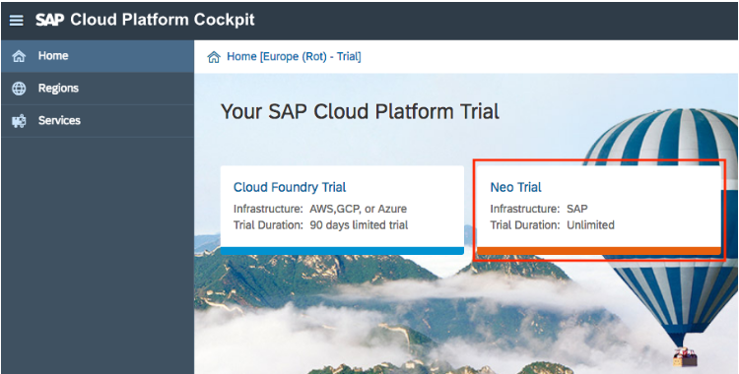
Sign up Free Trial Account on SCP
https://www.sap.com/india/developer/tutorials/hcp-create-trial-account.html

Slide 12
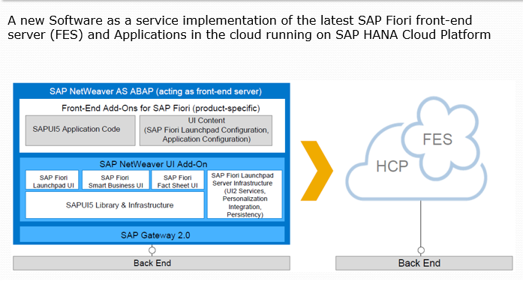
Introduction to SAP Fiori in the Cloud.

Slide 13
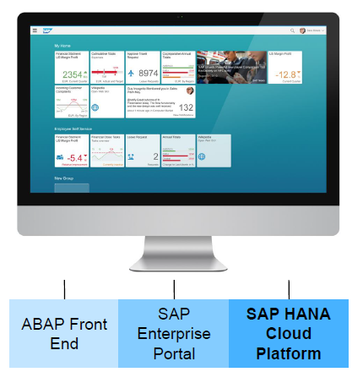
Introduction to SAP Fiori in the Cloud.

Slide 14
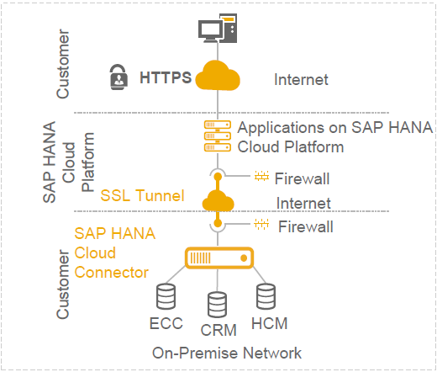
SAP Cloud Platform Connectivity Services.

Slide 15
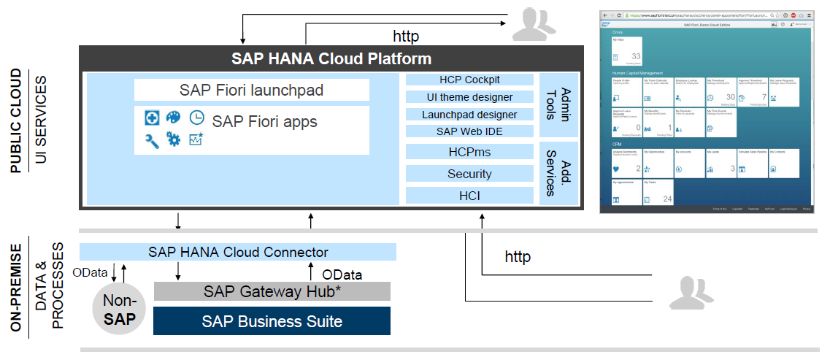
Introduction to SAP Fiori in the Cloud Architecture

Slide 16
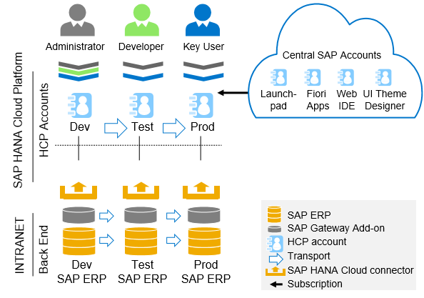
SAP Fiori in the Cloud Account

Slide 17
SAP Fiori in the Cloud. SAP HANA Cloud Portal
SAP HANA Cloud Portal is a simple and easy to deploy cloud offering designed to create intuitive customer, partner, and employee business sites
SAP HANA Cloud Portal is delivered with predefined site templates : SAP Fiori Launchpad for employee-facing site (entry point).
Customers can either use predefined templates or design and build their own custom sites.

Slide 18
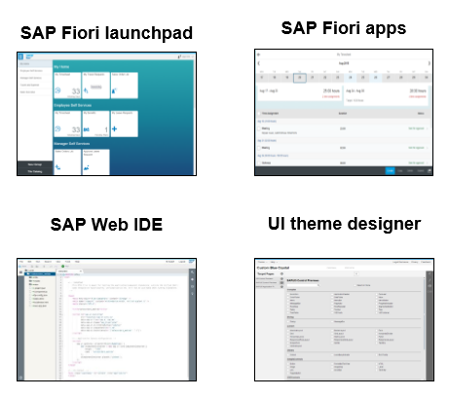
SAP Fiori in the Cloud UI building blocks in the cloud

Slide 19
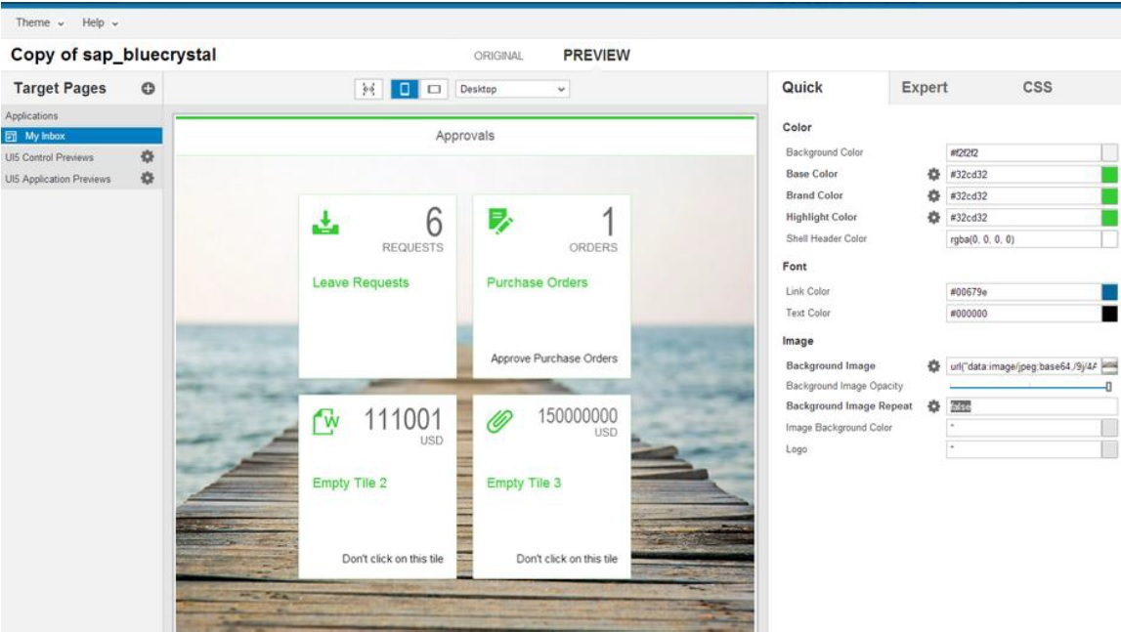
UI Theme Designer

Slide 20
Try it out today! Get a free SAP HANA Cloud Platform Developer License!
http://hanatrial.ondemand.com

Slide 21
Thank You

